Slide 1
St. Louis Brewery Location
By: Paul Gilbert

Slide 2




Introduction
St. Louis, Missouri is a well known location for restaurants and pubs. It is a large city (the largest in Missouri) where large amounts of people attend various places to eat and drink. This being the case, it is a great location for a company looking to start a brewing business. Some questions that would arise when attempting to find the right location for a business might be:
1) Are there nearby breweries and pubs that may take potential business away?
2) Are the closeby restaurants that may entice people away?
3) Is my location far enough away from these businesses that I will be one of the only options to try?
4) Is my location close enough to the urban centers that business will have a high potential?
5) Am I along a major thoroughfare?
Information to answer these question would be quite valuable. This analysis will attempt to do so.

Slide 3
Data Sources
The data that will be used in this report are as follows:
Data on Missouri Counties("https://data.mo.gov/Geography/Missouri-county-centroid-map/miam-vibb")
2) Foursquare Developers Access to venue data: https://foursquare.com/
These free sources will allow us to obtain specific venue information in specific counties in Missouri.

Slide 4
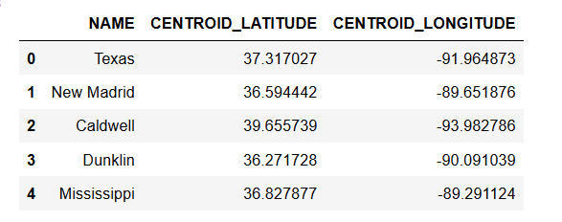
List of Missouri Counties
We are looking for counties in St. Louis. This includes St. Charles, St. Louis and St. Louis City counties.

Slide 5
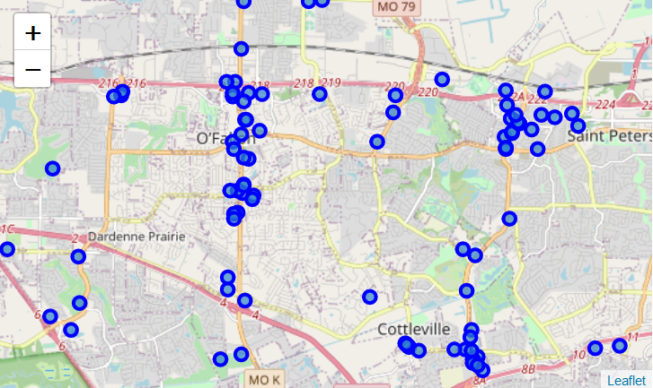
Venues in St. Charles

Slide 6
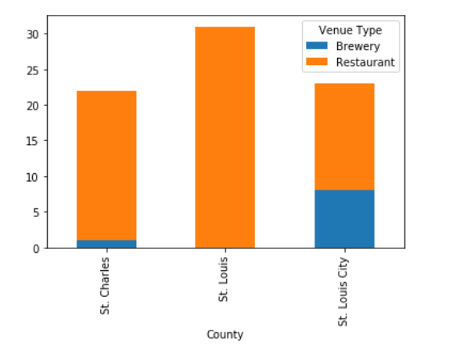
Barplot of Restaurants and Breweries in St. Louis

Slide 7
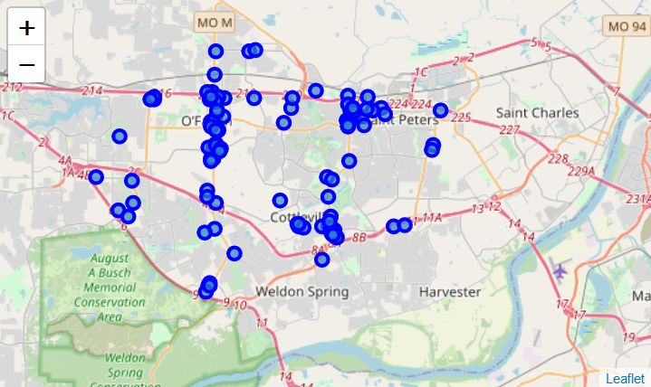
Map of Restaurants and Breweries in St. Charles county

Slide 8
Results
As can be seen from the data, there are not many breweries in St. Charles or even St. Louis counties. The number of breweries doesn't increase much until St. Louis City county. With this being the case St. Charles county seems like an excellent county for a new brewery to take off.

